Slide 1
Design of portable concrete mixture Prajwal Chandrashekhar Wani

Slide 2
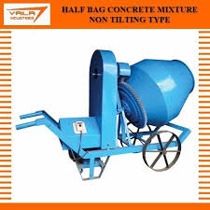
Introduction
A concrete mixture, also known as concrete mix or concrete batch, refers to the combination of various materials that are blended together to create concrete. Concrete is a versatile construction material composed of cement, aggregates (such as sand and gravel), water, and sometimes additional additives or admixtures.

Slide 3
Objective:
The objective of designing a portable concrete mixer is to create a compact and efficient system that can effectively blend cement, water, and aggregates to produce quality concrete. This design aims to provide mobility and reliability for on-site construction projects

Slide 4
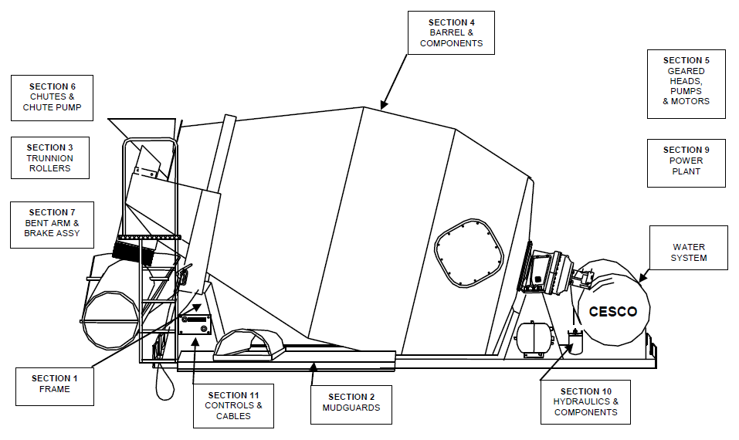
Components:
A concrete mixture machine, often referred to as a concrete mixer or concrete mixing machine, typically consists of several key components:
Drum or Mixing Chamber: This is the main part of the machine where the concrete ingredients are mixed together. It can have various designs, such as a drum that rotates horizontally or a mixing chamber with blades that move the materials around.
Electric Motor or Engine: This provides the power to rotate the drum or operate the mixing blades, depending on the type of mixer. Electric motors or gasoline/diesel engines are commonly used to drive the machine.
Chassis or Frame: The mixer is usually mounted on a sturdy frame or chassis to support the weight and ensure stability during operation.
Hopper or Loading Chute: This is where the raw materials, such as cement, sand, gravel, and water, are added to the mixer. The operator loads these components into the hopper to initiate the mixing process.
Control Panel: In some modern concrete mixers, you may find a control panel for adjusting the mixing speed, direction, and other settings, especially in the case of electric mixers.
Wheels: Many portable concrete mixers have wheels for easy mobility, allowing them to be moved to different job sites or positions.
Handle or Controls: Hand-operated concrete mixers often have handles for manual control. They can be adjusted to control the direction and speed of the mixing process.

Slide 5
Methodology
The methodology for using a portable concrete mixer typically involves several steps to ensure that you create a consistent and well-mixed concrete mixture. Here's a general guideline for using a portable concrete mixer
Research and Analysis: Study existing technologies and concrete mix proportions to inform your design.
Proportion Calculations: Determine the exact ratios of cement, sand, gravel, and water for the concrete mix.
Drum Design: Design the mixing drum, considering its capacity and structural integrity.
Supporting Components: Create designs for the yoke, base frame, and hand wheel that will hold and operate the mixer.
Safety and Quality: Ensure safety and quality by using analysis and simulations to assess the design.
Prototype Development: Build a prototype and conduct thorough testing to verify its performance.
Refinement: Make improvements to the design based on test results and feedback.

Slide 6
Calculations:
Data for Calculations:
Mass of Cement = 10 Kg, Mass of Sand = 30 Kg, Mass of Gravel = 60 Kg, Mass of Water = 5 Kg, Total Mass = 105 Kg, Factor of Safety = 2, Assumed Mass (Total Mass x FOS) = 210 Kg, Volumetric Capacity = 0.0808 m3, Length of Drum = 0.5 m, Diameter of Drum = 0.45 m, Thickness of the Drum = 6mm, Mixing Force (Assumed Mass x g) = 2060N, Minimum RPM of Drum for proper mixing = 25, Power of Motor = 1.49 kW (2HP), Torque of Motor = 900 Nm
So, the total Load acting on the yoke (or the main frame) during the process of mixing =
DRUM ASSEMBLY LOAD + LOAD DUE TO
ONE FULL BATCH = 2989 N
Determination of Maximum force required:
W = MT x g MT = Mass of concrete + mass of drums = (105+200) = 305 Kg Therefore Force required for proper mixing
= (305 x 9.8) = 2990N
Determination of Mixing Volume: Vmc = πr2h , Vmc = Volume of Mixing chamber r = 0.225m h = 0.500m ∴ Vmc = π x (0.225)2 x (0.5) = 0.80 m3
Determination of Belt Length: L = π( r1 + r2 ) + 2x + ( r1 + r2 )2 / x r1 & r2 = Radii of Smaller and Larger Pulleys
x = Distance between the centre of 2 pulleys = 2d1 + d2 = 2(0.070) + 0.135 = 0.275 m ∴ L = 0.32185 + 0.55 + 0.003 L = 0.875 m
Determination of Lap Angle: α = 180 ± 2sin-1 (D2-D1/2C) For open belt, (used in this case), α is given as: 180 – 2sin-1(D2-D1/2C) ∴ α = 180 – 13.575 = 166.425°

Slide 7
Calculations:
Number of teeth on Ring Gear of Drum:
Motor: 2HP, General Purpose, 3 Phase & 500 RPM Considering that 25 RPM is adequate for proper mixing,
D1 = Diameter of driver pulley = 0.070m ,D2 = Diameter of driven pulley = 0.135m N1 = Speed of Driver = 500 RPM N2 = Speed of Driven ∴ N1/N2 = D2/D1 ∴ N2 = N1xD1/D2 = 500 x 0.070/-0.135 ∴ N2 = 260 RPM
NB = Speed of Bevel Gear = 260 RPM NB = 260 RPM NR = 25 RPM TB = 13 (Standard) ∴ NB x TB = NR x TR 260 x 13 = 25 x TR ∴ TR = 260 x 13/25 = 135
Determination of Torque: T = Fl , T = Torque ,F = Mixing Force = 2990 N , L = Length of Paddle = 0.30m ∴ T = 2990 x 0.30 = 900 Nm
Determination of Shaft Speed: N = 500 RPM DS (Shaft Diameter) = 0.10 m V = πDN / 60
= 3.142 x 0.10 x 500 / 60
= 2.6m / sec

Slide 8
Parameters
SR NO. | PART | HEIGHT/LENGTH (m) | DIMETER (m) | WIDTH (m) | NO OF TEETH
1 | DRUM LOWER | 0.5000 | 0.450 | 0.060 | NA
2 | DRUM TOP | 0.5000 | 0.450 | 0.060 | NA
3 | DRUM BRACKET | 0.1000 | 0.250 | - | NA
4 | YOKE | 0.900 | 0.050 | - | NA
5 | MAIN FRAME | 1.215 | - | 1.260 | NA
6 | WHEELS | - | 0.300 | 0.040 | NA
7 | RING GEAR | - | 0.920 | 0.040 | 135

Slide 9
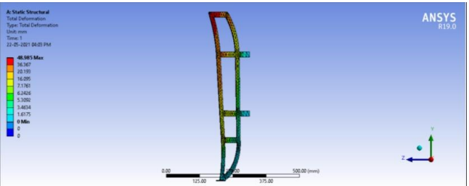
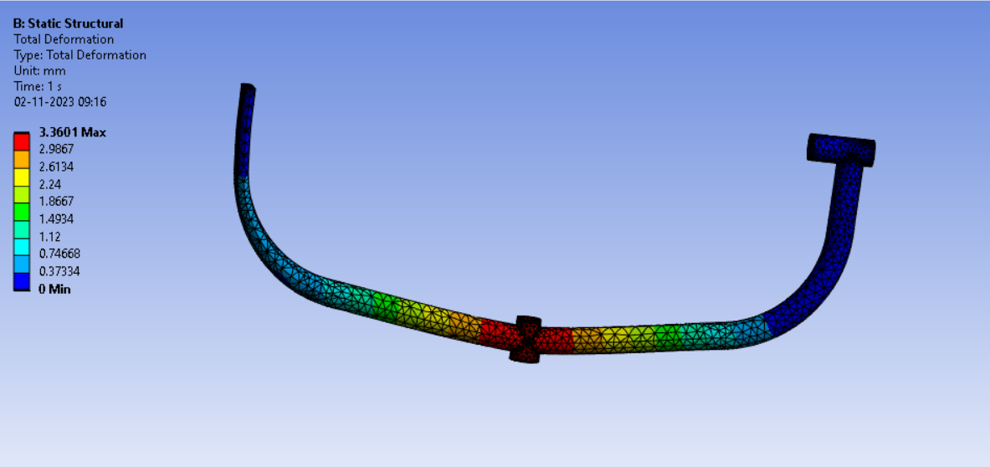
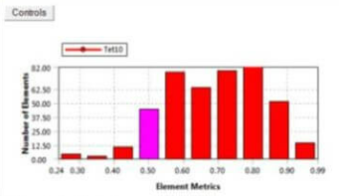
Analysis
Blade
Yoke

Slide 10
Conclusion:
In response to the growing demand for concrete, especially in emerging nations, mechanization is crucial. After thorough calculations, a mobile concrete mixer was designed to produce M10 grade concrete. The design proved safe with acceptable deformations. Complex mixing variables, including energy, loading, and time, were considered. Stainless steel blades were chosen to address issues like strength and corrosion.

